Slide 1


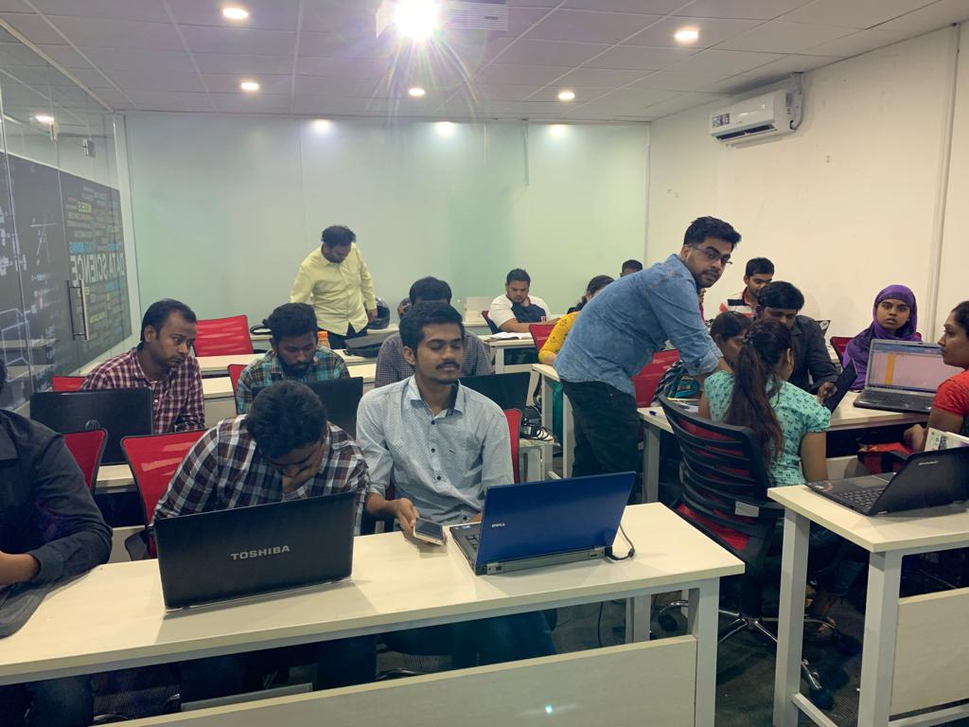





Slide 2
BFH : Budget Friendly Hotels Domain: Hospitality and E-Commerce
Presented by,
Soujanya and Darshana

Slide 3
Business understanding of the use case:
The hospitality industry is a huge sector which comprises of hotels all over the country, as part of this project we have gathered information of hotels from 7 prime cities where we have attempted to analyze the hotels based on few factors, i.e. price, customer ratings, comment type and amenities provided by the hotel.
Objective of the Project:
Find budget friendly hotel, with their best amenities.

Slide 4
Data Collection
Website for scraping data
To scrape the data we have used the website: www.oyorooms.com
To scrape the data we have used BeautifulSoup. As, it extracts the html for the page and stores it as an unstructured data and we have to convert that into a structured format.
Scraping methodology:
Step 1:Import all the necessary libraries
Step 2:Find and load the URL to scrape the data
Step 3:Load and explore the BeautifulSoup
Step 4:Collect the data using BeautifulSoup and extract the data
Step 5:Store the data into DataFrame
Step 6:Export the DataFrame into .CSV format

Slide 5
Data cleaning
Steps to Clean Data:
Import the .csv file
Analyze the data
Converting the datatypes of required columns to float
Handling the missing data
Using Regex and lambda functions to check if a particular string exists or not
Dropping the columns which were not required for further analysis
Export the filtered data into a new .csv file

Slide 6
Challenges faced:
Data Collection:
When sending an HTTP request to the specified URL and saving the response from the server in a response object, got Response error in loading the page.
When the page has been run for a number of times, got Connection error or Timeout error.
While collecting data, handled 'Attribute errors' by using try and catch exceptions.
Data Cleaning:
Split absent amenities into individual variable.
Data Cleaning – Handle Null Values in Rating, No. of Ratings and Comments.

Slide 7
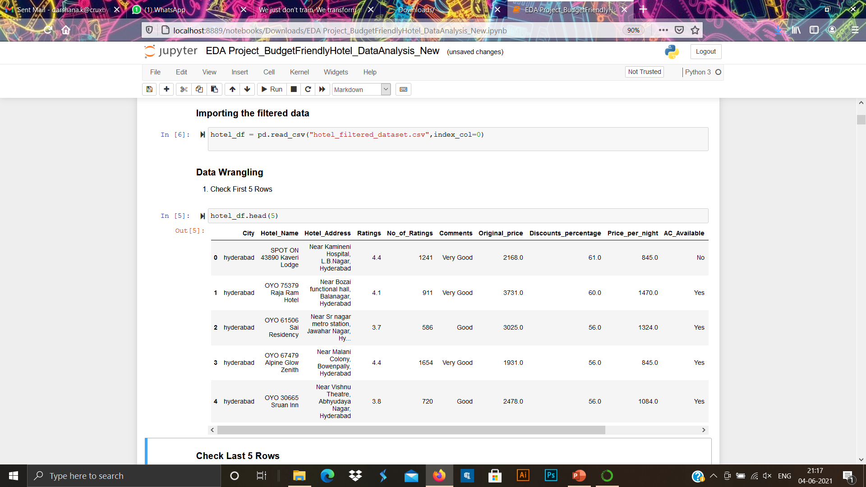
Insights From Data
This Data has 12 Variables and 1054 Observations.
In this data we have,
- Numerical features: Ratings, No_of_Ratings, Original_Price, Price_per_night, Discounts_percentage
- Categorical features: City, Comments, Amenities - AC_Available, TV_Available, WiFi_Available
They are no null values present in the filtered data.
Rating ‘0’ means it is a new hotel and has no comments.

Slide 8
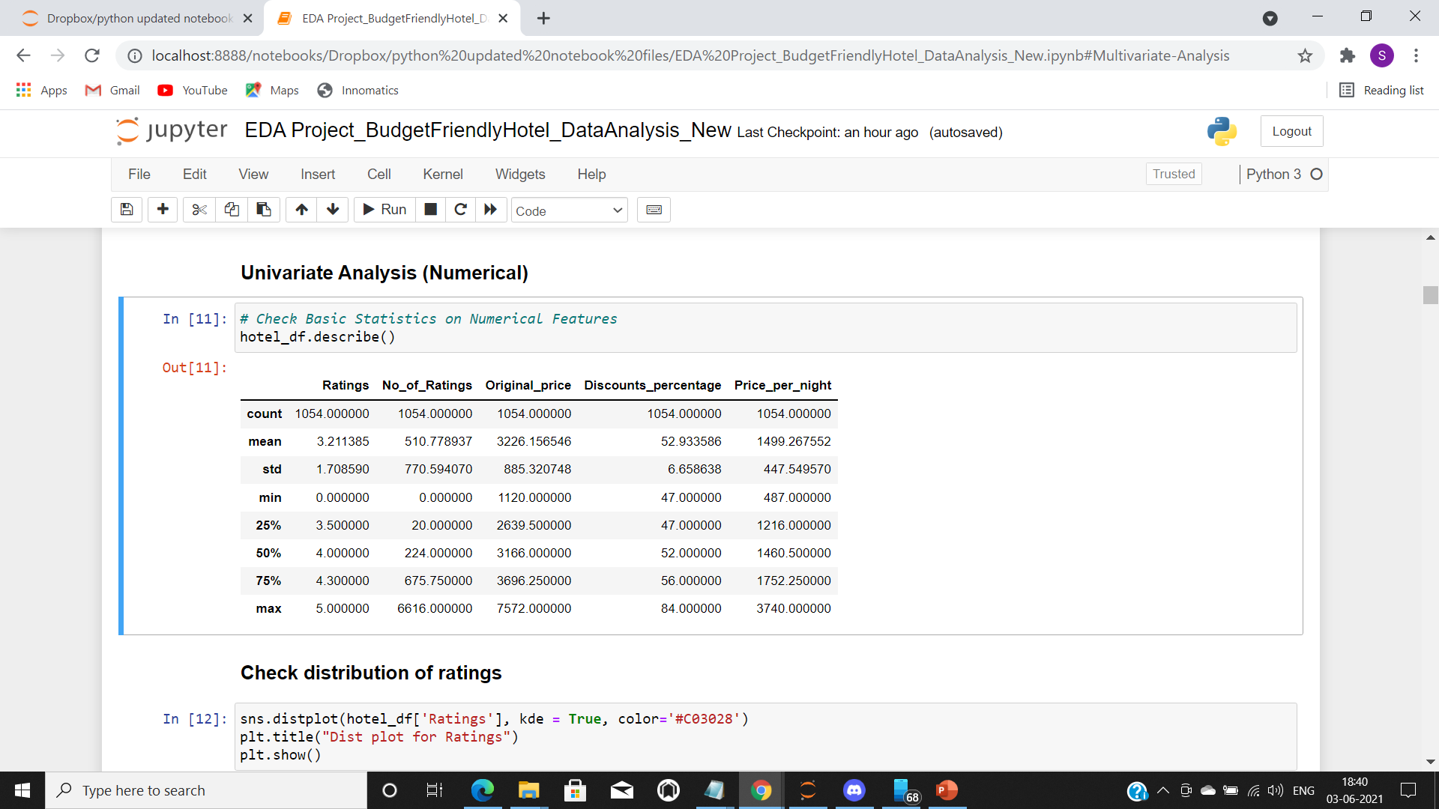
Data visualization
Univariate Analysis (Numerical)
Basic Statistics on Numerical Features:

Slide 9
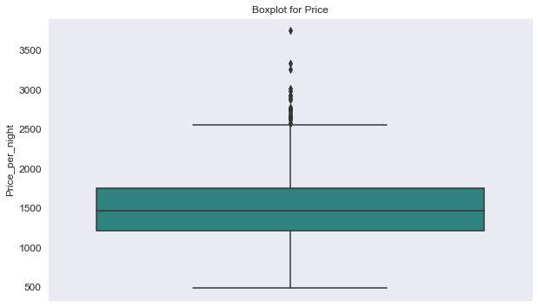
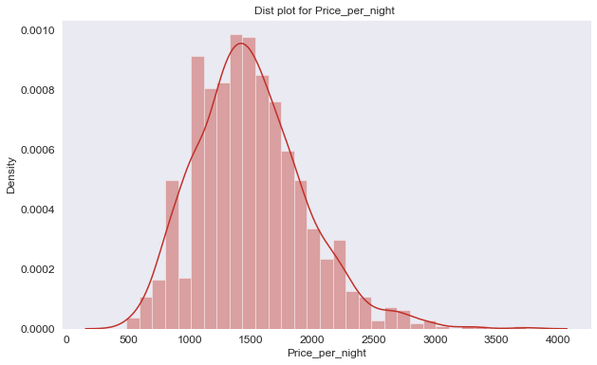
Check distribution for price_per_night
Outliers are present above INR 2500
Spread of data is in between INR 400 - 2500
We can see that minimum price is starting from INR 500 to 1200
Median is around INR 1500
We can see that 75% quartile is around INR 1700
We can see, Price_per_night is showing left skewed distribution because of outliers.

Slide 10
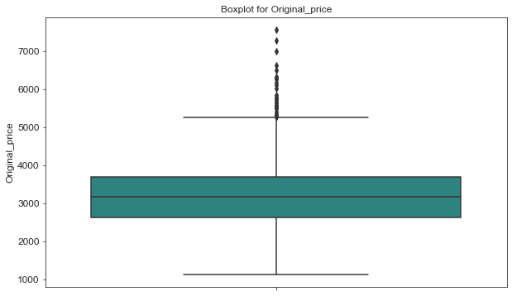
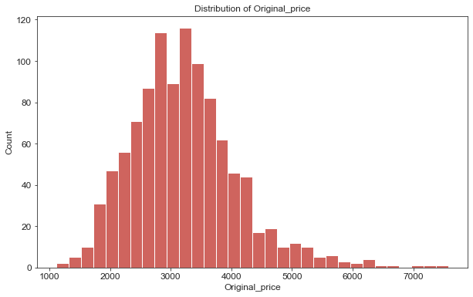
Check distribution for original_price
Nature of distribution is same as Price_per_night
Outliers are present above INR 5200
Spread of data is in between INR 1100 - 5200
We can see that minimum price is starting from INR 1100 to 2700
Median is around INR 3100
We can see that 75% quartile is around INR 3600
We can see, Original_price is showing left skewed distribution because of Outliers.

Slide 11
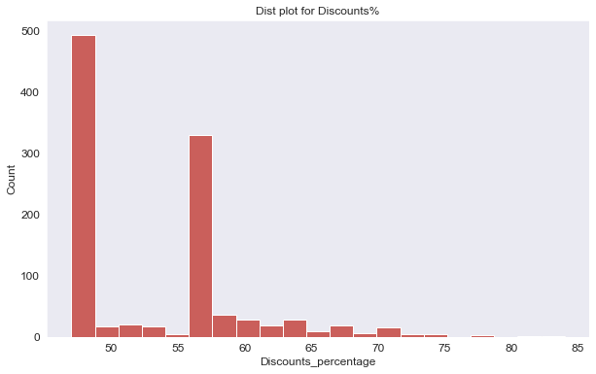
Check distribution for discounts_percentage
Most of the hotels are giving 47%-48% and 56%-57% Discounts on their original price.

Slide 12
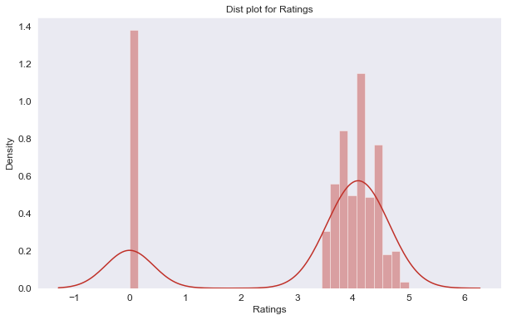
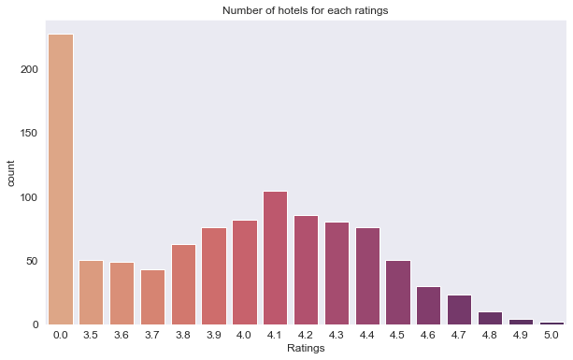
Check distribution for ratings
We can see, ratings are showing symmetric distribution for ratings in between 3.5 to 5
Most of the hotels are new so they have 0/5 rating
We have more number of hotels which have 4.1/5 ratings
Least number of hotels which have 4.9/5 & 5/5 ratings

Slide 13
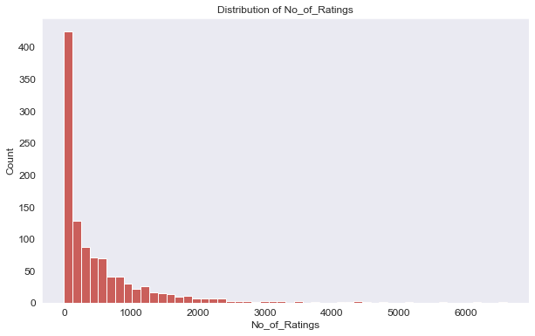
Check distribution for number of ratings
We can see for No_of_Ratings are showing left skewed distribution.

Slide 14
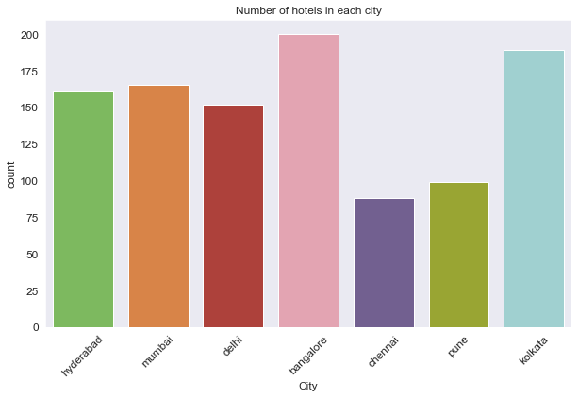
Univariate Analysis (Categorical) Check the distribution for the number of hotels in each city
We can see that most of the hotels are in Bangalore and then in kolkata.
Hyderabad and Mumbai have almost same number of hotels
Chennai has the least number of hotels in our dataset.

Slide 15
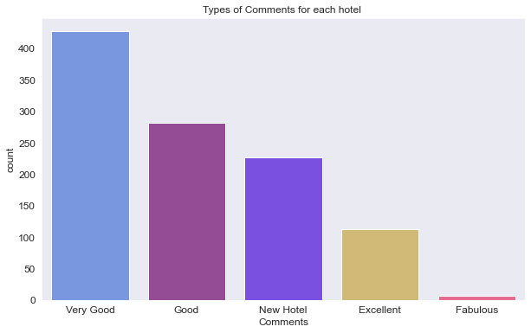
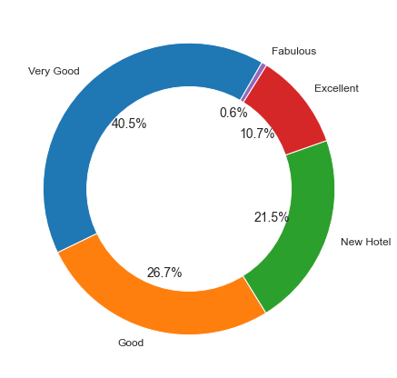
Check the distribution for types of comments for hotels
We can see that most of the hotels have Very Good comments followed by Good and Excellent
Fabulous comment has least number of hotels.
New Hotels are there which have no comments.

Slide 16
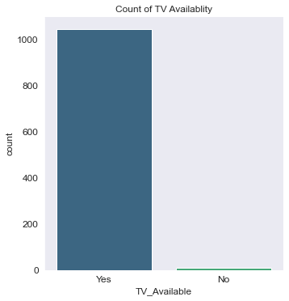
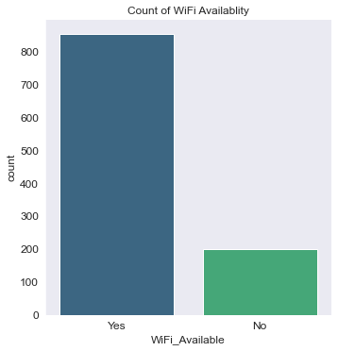
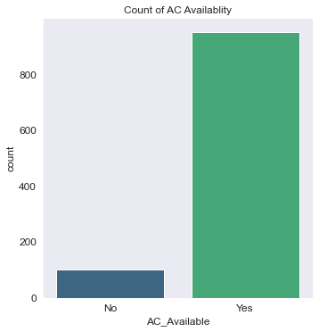
Check the distribution for AC,TV and WIFI availability
We can see that most of the hotels have AC and WiFi as one of the amenities.
We can see that almost all of the hotels have TV as one of the amenities

Slide 17
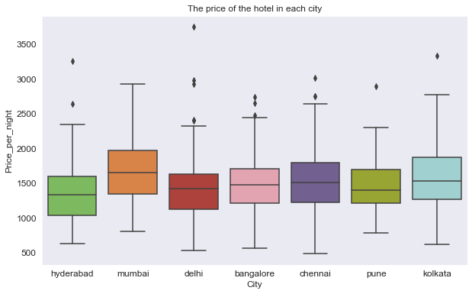
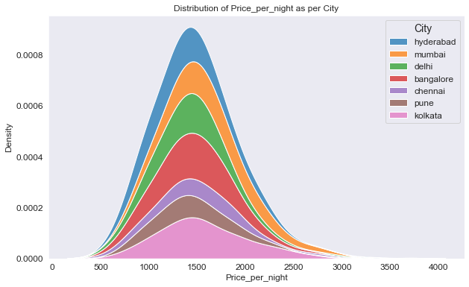
Bivariate Analysis Check the price of a hotel for each city
Outliers are present starting above INR 2300
Spread of data is in between INR 400 - 2900
Median is almost same for all the cities, except for Mumbai
Pune City has less Spread, that means it has In-Budget hotels
Mumbai Has Expensive Hotels.
Kolkata has wide range of Price than other Cities.

Slide 18
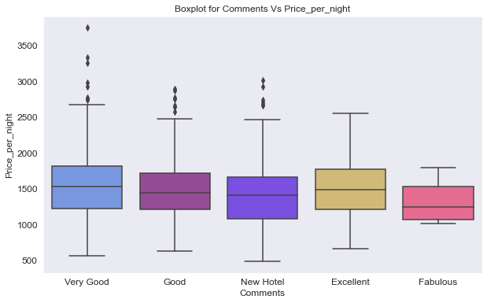
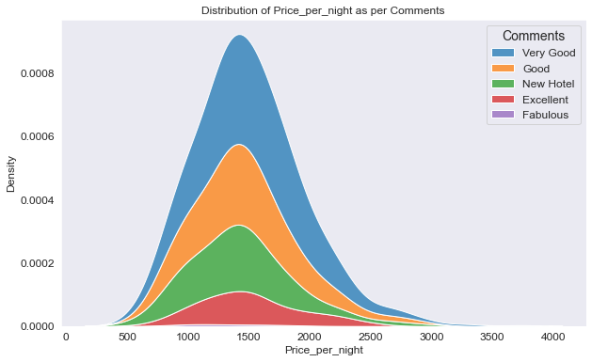
Distribution of Price_per_night as per Comments
Outliers are present in Very Good, Good and New hotels Comments
Very Good Comment hotels has wide price range
Fabulous Comment hotels has less price range and higher ratings

Slide 19
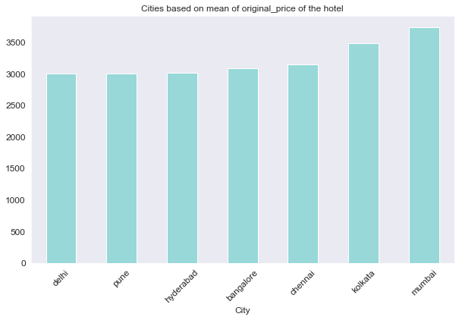
Distribution based on mean of original_price of the hotel for all the cities
The average original price of the hotels found high in cities 'Mumbai' and 'Kolkata’, followed by remaining cities.

Slide 20
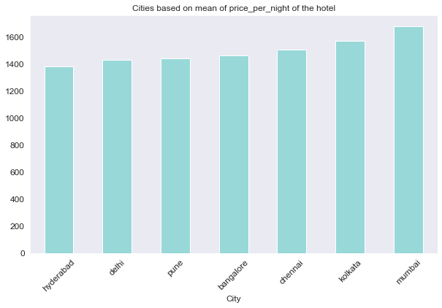
Distribution based on mean of price_per_night of the hotel for all the cities
The distribution of original price and price_per_night is almost the same.
The average price of the hotels found high in 'Mumbai’.
Compared to other cities, the average price of the hotels found low in ‘Hyderabad’.

Slide 21
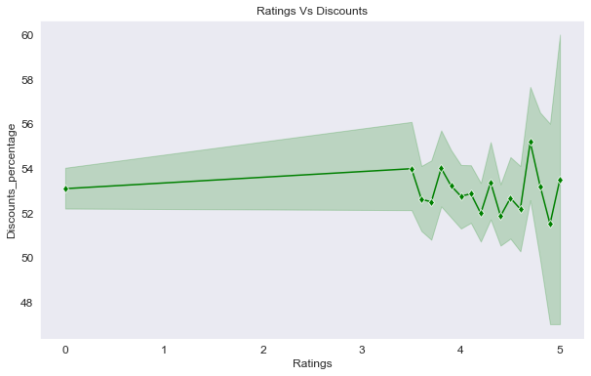
Ratings vs Discounts_percentage
Few hotels have got ratings 4.9 and 5 and the discount percentage is within 51% to 53%
From rating 0 to 3.5,they are no ratings given

Slide 22
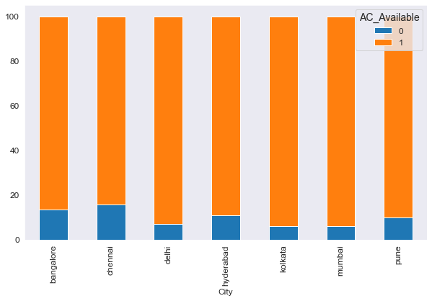
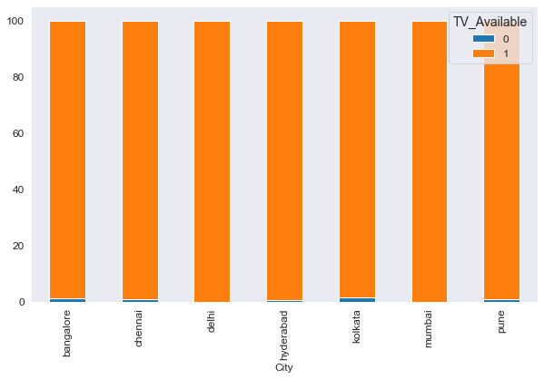
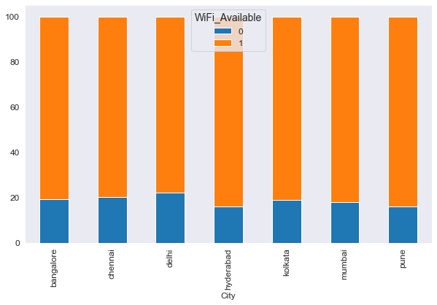
Check for availability AC, TV and WiFi in each city
Kolkata and Mumbai has most number of 'AC' available hotels.
Compared to other hotels, Chennai has the least number of 'AC' available hotels.
Almost in every city TV is available
Compared to other hotels, Hyderabad has the least number of ‘WiFi' available hotels.

Slide 23
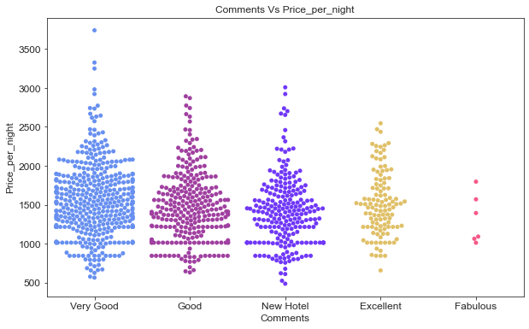
Comments Vs Price_per_night
For the comment 'Very Good' has higher price and maximum hotels are present.
For the comment Fabulous has lesser price and less number of hotels are present.

Slide 24
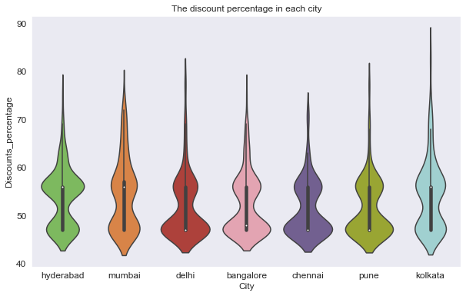
Distribution of the discount percentage in each city
The minimum discount percentage is 42%
The median values for 'Delhi’, 'Bangalore’, 'Chennai' and 'Pune' cities is almost (45%) same.
The median values for 'Hyderabad’, 'Mumbai' and 'Kolkata' cities is almost (57%) same.

Slide 25
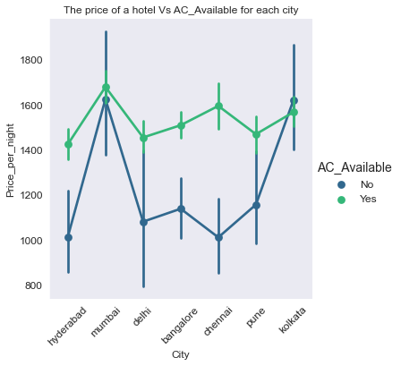
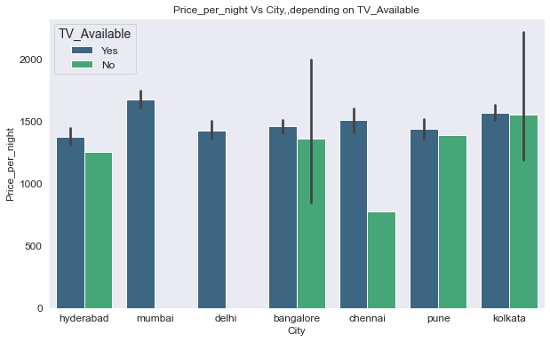
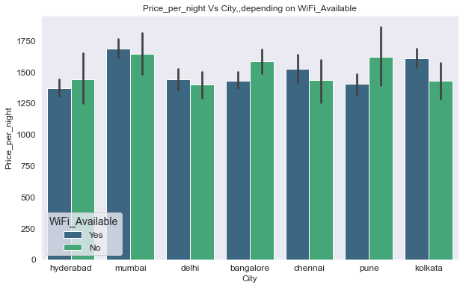
Multivariate Analysis Price_per_night Vs city, depending on AC,TV and WiFi Availability
AC availability is 'Yes' the price_per_night is within INR 1400 – 1700
TV availability is 'Yes' or 'No', Kolkata has almost same price_per_night
TV availability is 'Yes' or 'No', Hyderabad, Bangalore and Pune also has almost same price_per_night
WiFi availability is 'Yes' or 'No’, the price_per_night is almost the same
WiFi availability is not depending on price_per_night

Slide 26
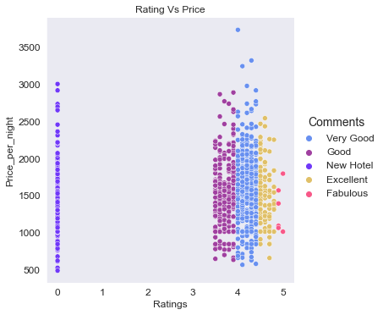
Check the relation for Ratings Vs Price_per_night
Ratings 4 to 4.5, comments are Very Good and the price is high
(INR 500-3500)
Few hotels have got ratings 4.9 and 5, comments are Fabulous and also the price is within the range of INR 1000 - 1700

Slide 27
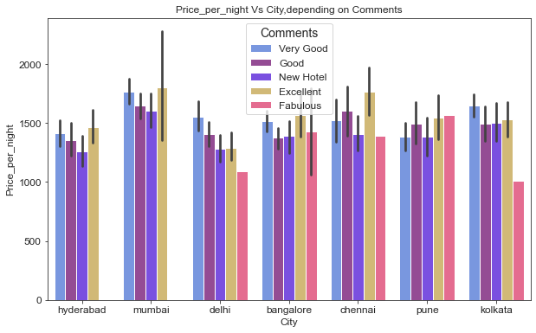
Price_per_night Vs City, depending on Comments
Comments:
Fabulous: 'Delhi’, 'Bangalore’, 'Chennai’, 'Pune' and 'Kolkata' cities.
Very Good: 'Mumbai’ ,’Delhi’ and 'Kolkata' cities has more price.

Slide 28
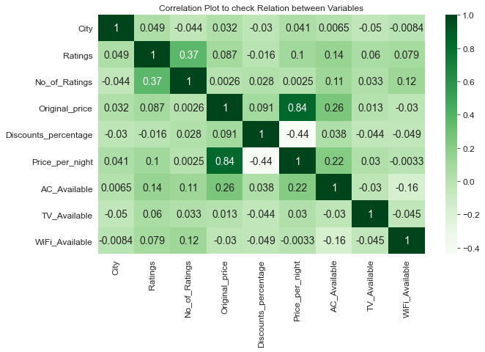
Check Co-relation between Important Variables
Ratings and No.of Ratings are positively correlated to each other.
Ac_ Available and price_per_night_ are correlated to each other
Discount_percentage and Price_per_night is negatively corelated to each other.

Slide 29
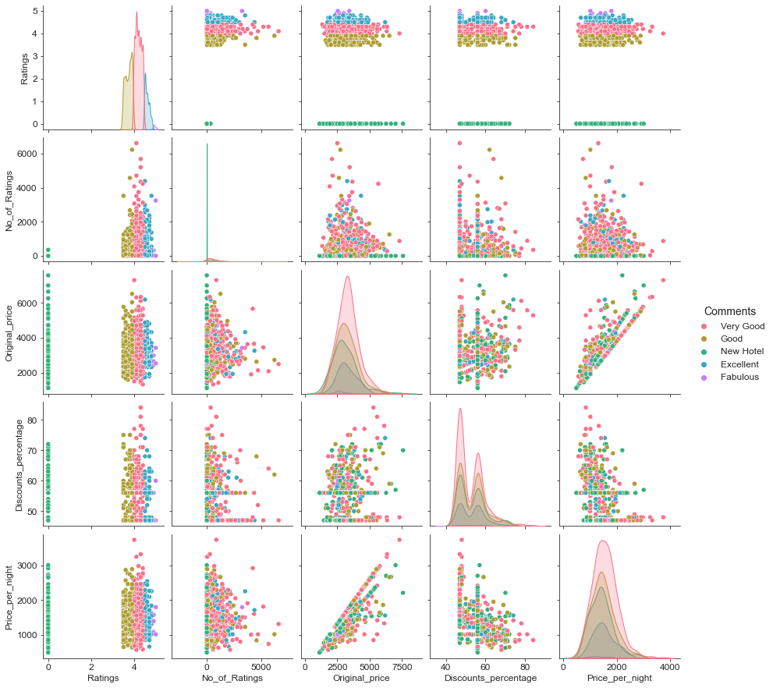
Check Relation between numerical variables based on Comments
For hotels which have “Very Good” comments, those price, no.of ratings,Discount_percentage are high
Relation between price_per_night and original_price

Slide 30
Interpretation and insight
Bangalore: Has maximum number of hotels along with 'AC' and 'WiFi'.
Chennai : Has minimum number of hotels along with 'AC' and 'WiFi'.
Kolkata : Distribution of price_per_night is high. Also, has most number of 'AC' and 'WiFi' available hotels.
Mumbai : Distribution of price_per_night is high.
The price_per_night is in the range from INR 500 to 3500.
Most of the hotels have given 47%-48% and 56%-57% discounts on their original price.
Rating 0 means it is a new hotel and has no comments.
Maximum number of hotels have given a 4.1/5 ratings.
Least number of hotels are given 4.9/5 & 5/5 ratings.
Maximum hotels have got 'Very Good' comments and has a higher price in the range of INR 600 - 2700.
AC, TV and WIFi is available in almost all the cities.
Whether TV availability is 'Yes' or 'No', Hyderabad, Bangalore and Pune have almost same price_per_night.
WiFi availability is 'Yes' or 'No', the price_per_night is almost the same and it is not depending on price_per_night.
Very few hotels have got ratings 4.9 and 5, comments as Fabulous and also the price is within the range of INR 1000 - 1700.

Slide 31
Your experience after the project
This project helped us to understand the basic concepts of python, along with NumPy and Pandas, how to 'web scrape' from the website, cleaning and filtering the data. It also gave us a clear vision of 'EDA' and 'Visualization'.

Slide 32
Future Scope of the Project
We can do some Machine Learning models on this data
- Cost Forecasting.
- To Group hotels in Several Categories.
If we get booking data, We can do more analysis and ML Models on that data.

Slide 33

THANK YOU

